Slide 1


(U-Th)/He dating: principles and applications
Cécile Gautheron
cecile.gautheron@u-psud.fr
Helsinki University – 26 octobre 2017

Slide 2
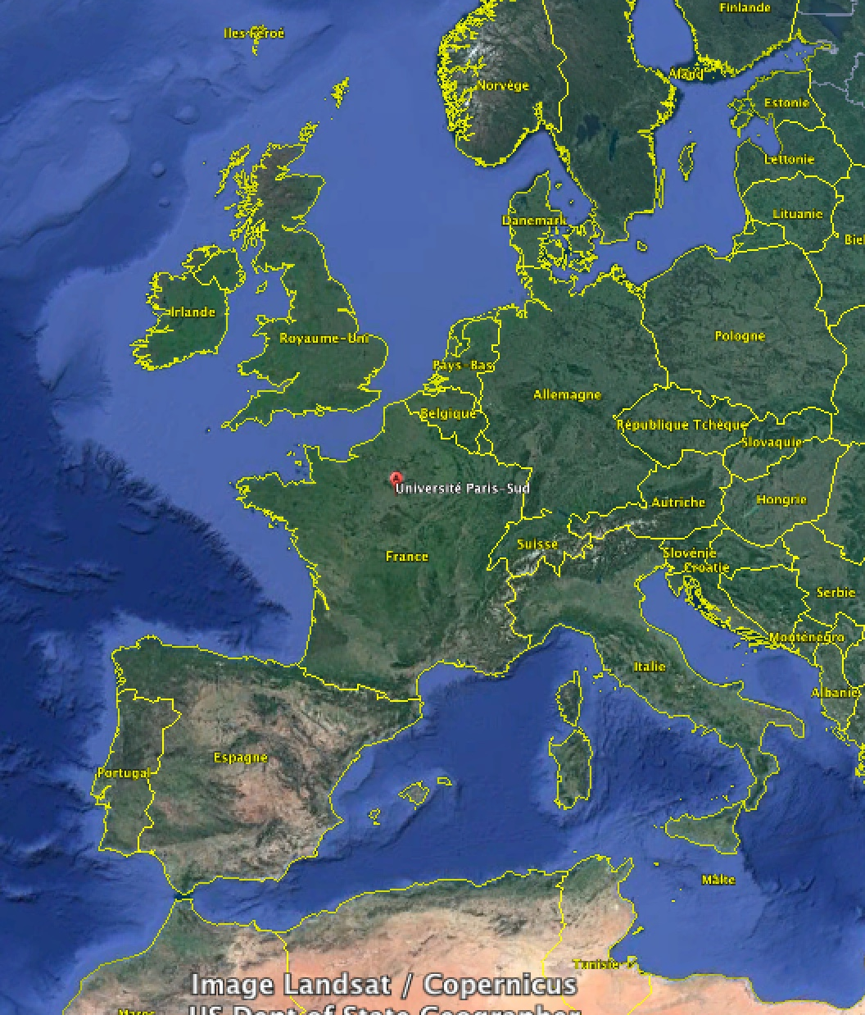



Paris universities
University of Paris Notre Dame (Sorbonne) was born in 1150 (2nd university in Europe)
=> Introduced several academic standards such as doctoral degrees

Slide 3
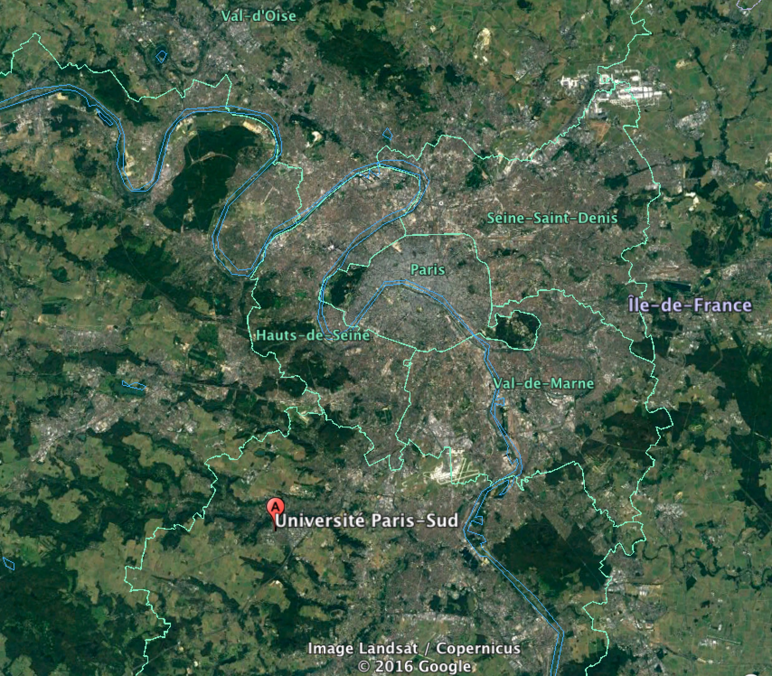




Paris universities
After 1968 => 15 autonomous universities
More than 7 universities with a Geosciences department
University Paris Sud 11 was born in 1955
30 000 students from 125 nationalities
2500 researchers (40 in the Earth Science department)
Pluridisciplinary research

Slide 4
(1) (U-Th)/He dating system
Introduction, generalities
(U-Th)/He principles (chronometer vs thermochronometer)
(2) How to get an (U-Th)/He age
(3) Applications
Apatite (U-Th-Sm)/He (AHe) method
Other applications (zircon, iron oxides,…)
(4) Exercises (Tc, ejection, weight, Rs), thermal modeling

Slide 5
(1) (U-Th)/He dating system
Introduction, generalities
(U-Th)/He principles (chronometer vs thermochronometer)
(2) How to get an (U-Th)/He age
(3) Applications
Apatite (U-Th-Sm)/He (AHe) method
Other applications (zircon, iron oxides,…)
(4) Exercises (Tc, ejection, weight, Rs), thermal modeling

Slide 6
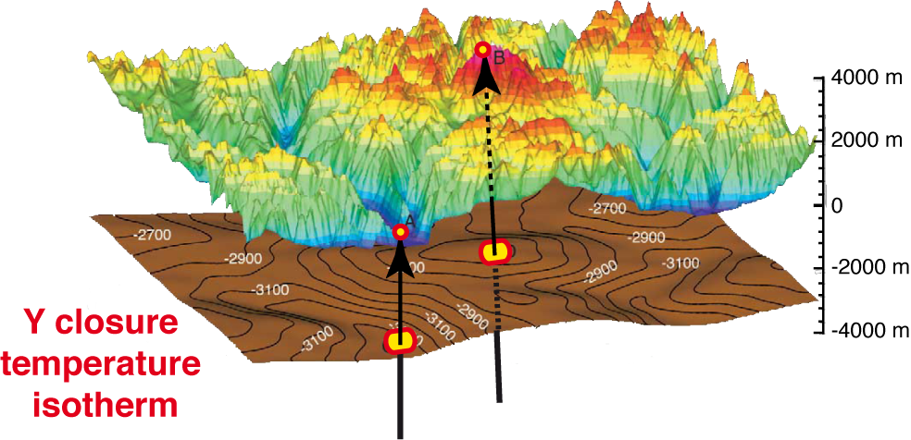
I. Quantification of rocks thermal evolution through time
Modified from Ehlers et al. (2003)
U-Th-Sm (parent) => He (daughter)
Complete daughter retention => chronometer
Daughter loss by diffusion => thermochronometer
(Closure temperature and Partial Retention Zone)
Notes:
Graph B a refaire en mettant oxydes de fer He – Ne et apatite He

Slide 7
I. Thermal sensitivity of thermochronometers
Low temperature
thermochronometers
(U-Th)/⁴He method applied on apatite, zircon and iron oxides
Thermal sensitivity from 40 to 200°C
Notes:
Graph B a refaire en mettant oxydes de fer He – Ne et apatite He

Slide 8
I. Meaning of thermochronological ages
Apatite He: 40-120°C
Apatite FT: 60-120°C
Iron oxides He: ~110°C
Iron oxides Ne: ~300°C
Age=f(a, D)~90-10 Ma
Age~10 Ma
Plutonic rock example:
Rock formation age > thermochronometric age

Slide 9
I. Meaning of thermochronological ages
Age=120 Ma
Apatite He: 40-120°C
Apatite FT: 60-120°C
Iron oxides He: ~110°C
Iron oxides Ne: ~300°C
Age~80-10 Ma
Age~10 Ma
Sedimentary, volcanic rock or iron oxides duricrust examples:
Rock formation age ≥ or ≤ thermochronometric age

Slide 10
I. Meaning of thermochronological ages
TAKE HOME MESSAGE:
A thermochronological age (or date) is an apparent age
Need to apply some corrections (alpha ejection, diffusion)
⁴He accumulation in crystal lattice reflects = f (thermal history, diffusion coefficient, grain size, …)

Slide 11
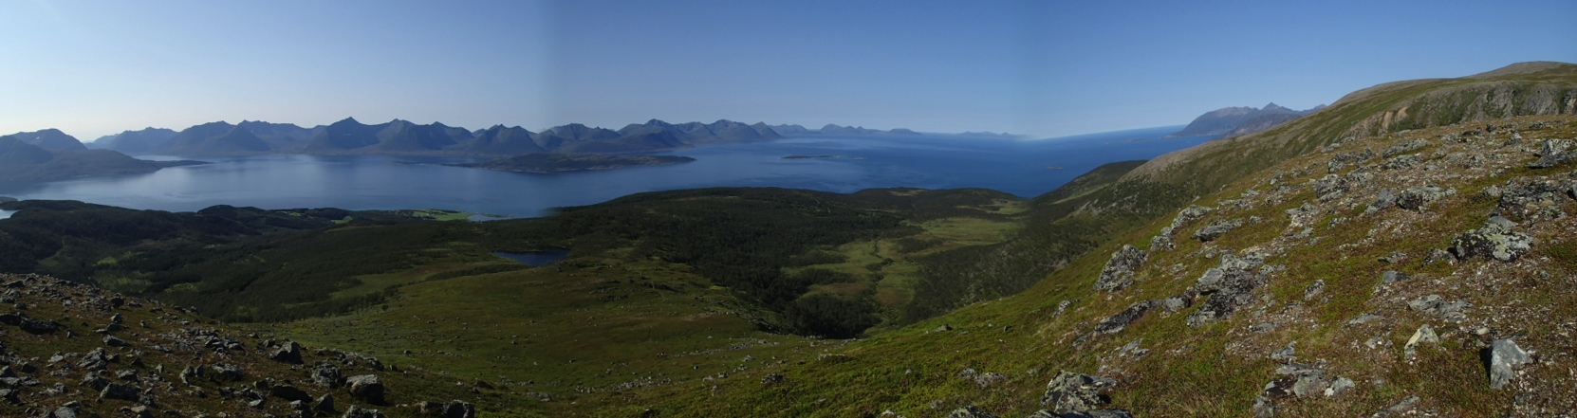
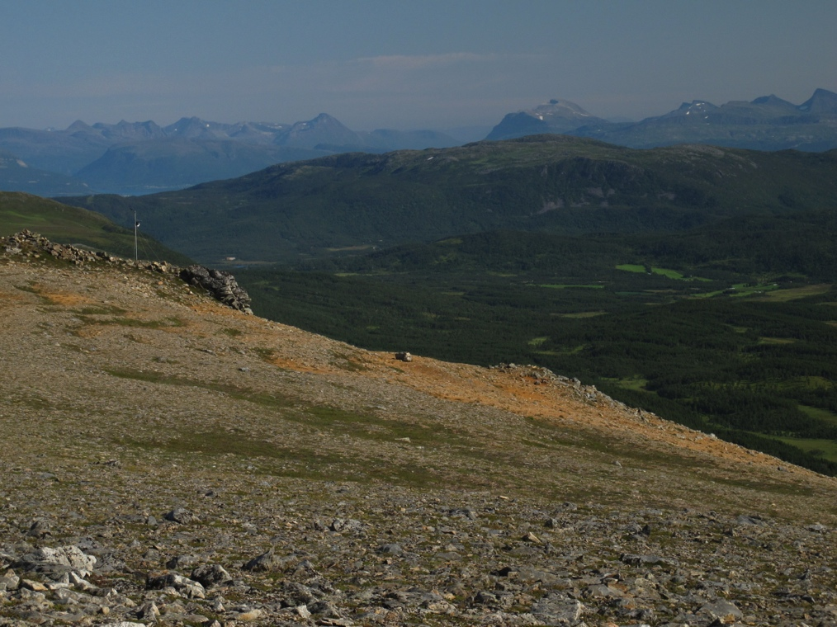
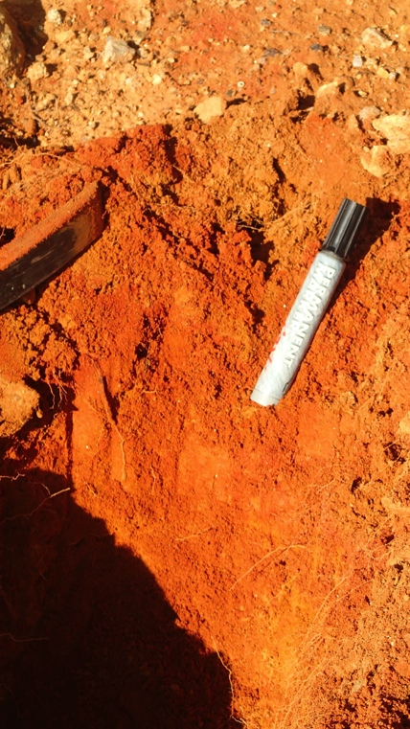
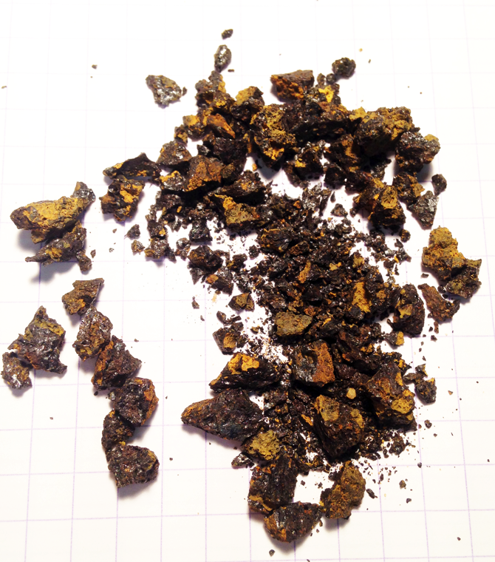
I. Quantification of erosion and weathering processes
Apatite, zircon, titanite… can be used to quantify rock thermal history and erosion processes …
Lofoten Island (Norway)
Rødmålheia on Hinnøya
Iron oxides (hematite, goethite) can be used to quantify weathering episodes (paleosurfaces), timing of ore deposits …

Slide 12
(1) (U-Th)/He dating system
Introduction, generalities
(U-Th)/He principles (chronometer vs thermochronometer)
(2) How to get an (U-Th)/He age
(3) Applications
Apatite (U-Th-Sm)/He (AHe) method
Other applications (zircon, iron oxides,…)
(4) Exercises (Tc, ejection, weight, Rs), thermal modeling

Slide 13
II. (U-Th-Sm)/He dating method principles
He atoms production in minerals during U, Th, Sm decay
Long alpha ejection (15-20 μm)
3) Possible diffusion in the crystal, depending on :
a) diffusion coefficients and
b) thermal history

Slide 14
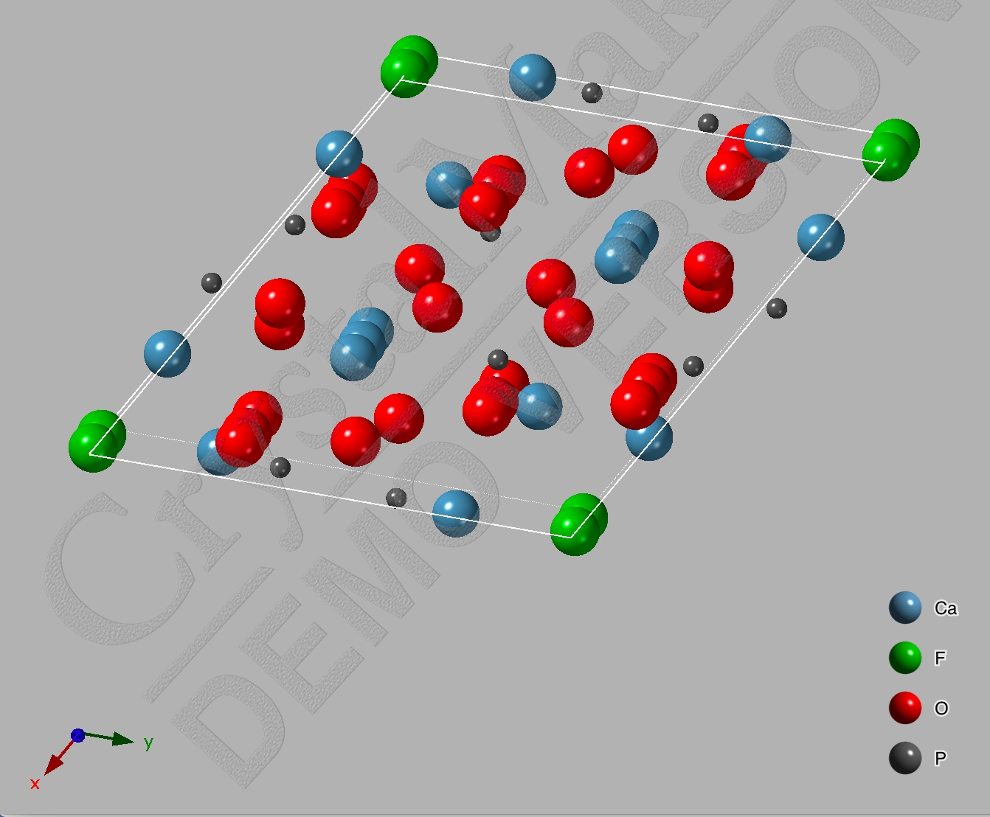
II. U-Th-Sm incorporation in crystal lattice
Apatite
http://www.crystalmaker.com/
U, Th and Sm incorporation (substitution or cluster) in almost any crystal lattice:
U = 0.01 - 1000 ppm; Th/U = 0.1 - 20; Sm = 10 - 3000 ppm

Slide 15
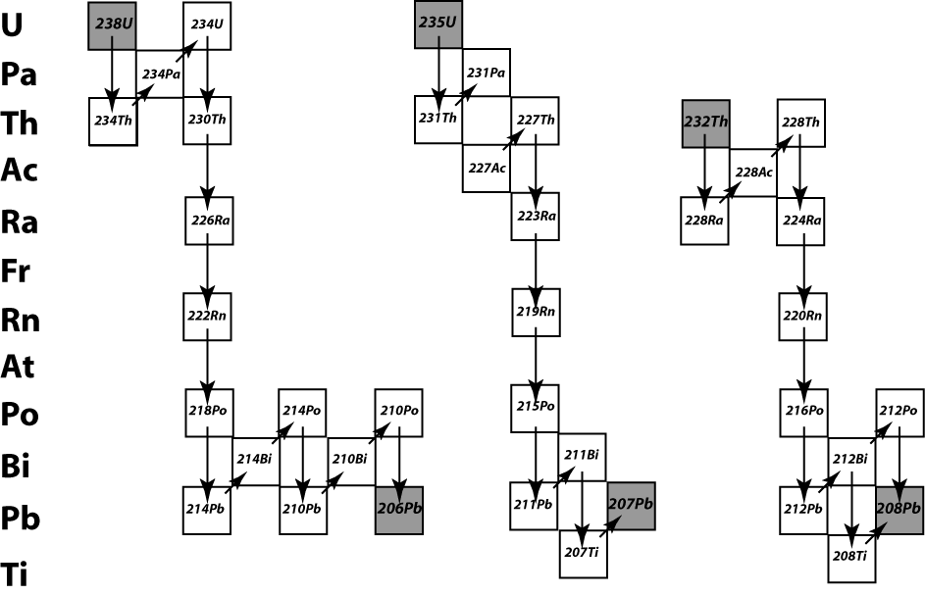
II. U-Th-Sm radioactive natural decay
²³⁸U natural fission
= 1 track / ~10⁶ alphas
²³⁵U + ²³⁸U = 99.99% U; ²³²Th = 100 % Th and ¹⁴⁷Sm = 0.15 % Sm

Slide 16
II. U-Th-Sm radioactive natural decay
Nb. α
particles
Half-live
(Ga)
Father
Daughter
²³⁸U -> ²⁰⁶Pb + 8 α (4.4683)
²³⁵U -> ²⁰⁷Pb + 7 α (0.7038)
²³²Th -> ²⁰⁸Pb + 6 α (14.05)
¹⁴⁷Sm -> ¹⁴³Nd + 1 α (106)
Alpha particles production during U-Th-Sm alpha decay

Slide 17
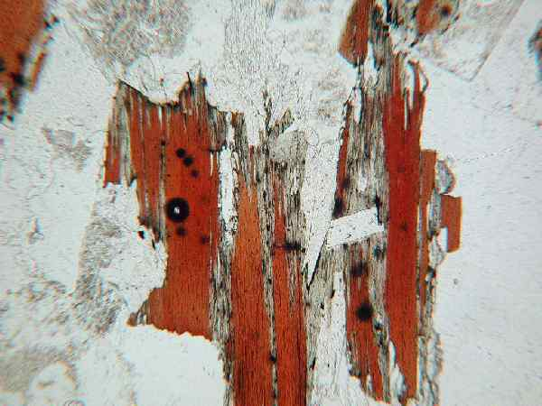
II. Alpha particles production => high energies
SRIM; Ziegler (2008); Ketcham et al. (2011)
Alpha halo in biotite
High kinetic energy of α particles,
α ------------> ⁴He (after taking electrons)
He atoms will stop after some microns depending on initial energy, lattice density, chemistry and Th/U ratio (See EXERCICE 1).

Slide 18
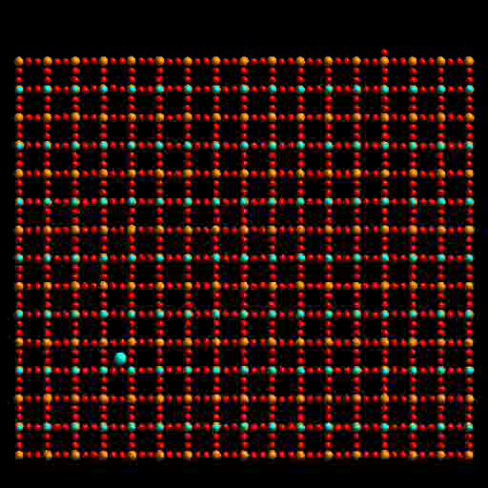
II. Alpha particles energies = recoil damage
Trachenko, 2003
Associated to alpha decays, the “father” element will do a recoil.
Damage creation at nanometer scale

Slide 19
II. ⁴He production
From ²³⁸U
and ²³⁵U
From
²³²Th
From
¹⁴⁷Sm
eU (effective Uranium) = U + 0.24 Th + 0.0005 Sm

Slide 20
II. Diffusion in minerals : microscopic or macroscopic point of view
Diffusion is a microscopic (atomic) process that can be seen :
Microscopic level :
1D
Djimbi et al. (2015)
Notes:
He and Ne are in insertion site and jump from one site to the neighbor one,
Random

Slide 21
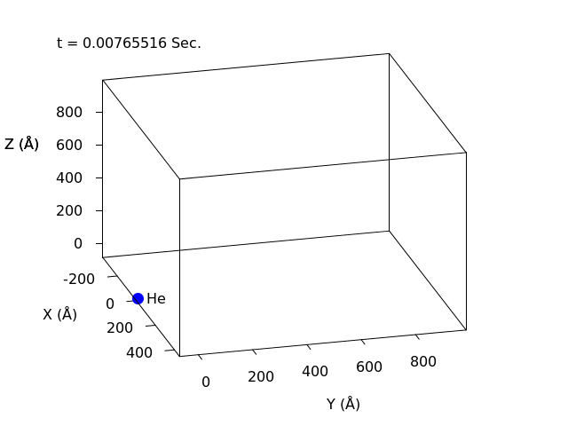
II. Diffusion in minerals : microscopic or macroscopic point of view
Diffusion is a microscopic (atomic) process that can be seen :
Microscopic level :
2D
3D
Balout et al. (2017)
Djimbi et al. (2015)
Notes:
He and Ne are in insertion site and jump from one site to the neighbor one,
Random

Slide 22
II. Diffusion in minerals : microscopic or macroscopic point of view
Diffusion is a microscopic (atomic) process that can be seen :
Macroscopic level :
Random diffusion can be described at macroscopic level using Fick’s law:
Gautheron et al. (2012)
Notes:
Heterogeneous repartition of He and Ne in crystal

Slide 23
II. Diffusion coefficient in minerals
At first order, diffusion coefficient, D, follows the Arrhenius law:
One unique D₀ and E_{a}
Different size (a) domains
Reiners (2009)
Notes:
This imply a bulk E_{a} and D₀ values
However, diffusion can be more complex with different E_{a} and D₀ along the a, b, c axis.
Need to describe and quantify all parameters that control He and Ne diffusion

Slide 24
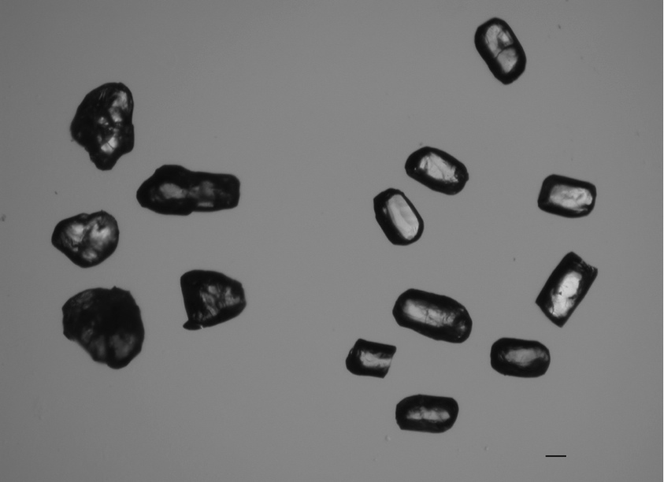
II. Diffusion in a simple system : one crystal
Farley (2000)
100 μm
Ehlers and Farley (2003)
The grain volume is the diffusion domain
One crystal size (a)
Similar D₀ and E_{a} for all the grain size

Slide 25
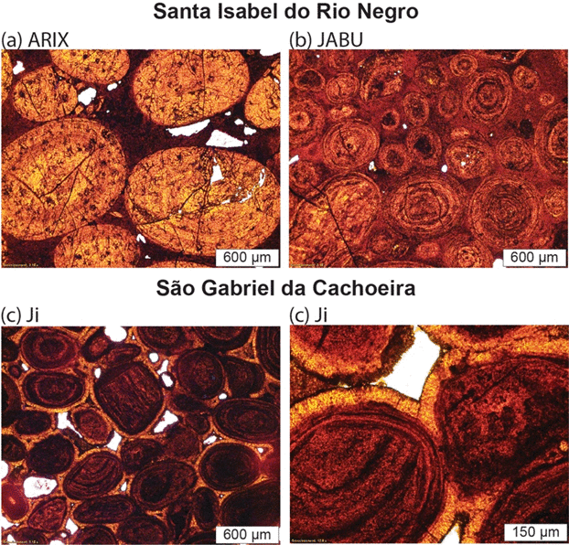
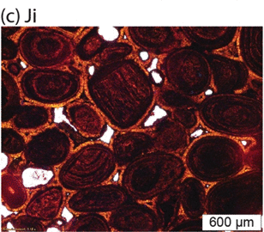
II. Diffusion in a complex system : polycrystalline structure
Polycrystalline structure in iron oxide crystals (hematite and goethite)
Different crystal sizes (a)
Difficulty to determine D₀ and E_{a}
Farley and Flowers (2012)
Allard et al. (Submitted)

Slide 26
II. Diffusion in a complex system : fast paths
Breccia and fault filling calcite samples from the Eocene/Oligocene Gondrecourt graben.
Copeland et al. (2007);
Lovera et al. (1989, 1991); Cros et al. (2014)

Slide 27
II. Diffusion in a complex system : use of a MDD model.
Helium diffusion data in calcite can be reproduced using a MDD model
Different domains (size)
Lovera et al. (1989; 1991); Gautheron and Tassan-Got (2010); Cros et al. (2014)

Slide 28
II. Diffusion in a complex system: some hypotheses
Different parameters can influence diffusivity in a crystal:
Gautheron et al. (in prep.)

Slide 29
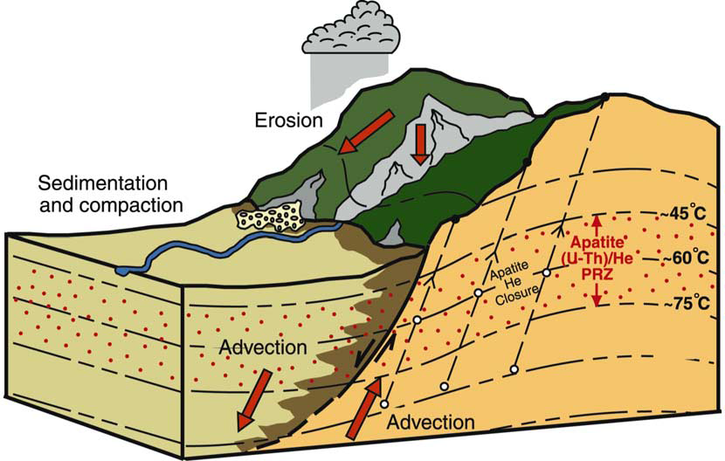
II. From diffusion coefficient to useable data
He retention in crystal depends on:
Grain size (a)
Diffusion coefficient (D₀, E_{a})
Thermal history (T-t)
Need to get useable values such as of:
Closure temperature (Tc)
He Partial Retention Zone (He-PRZ)
Ehlers and Farley (2003)

Slide 30
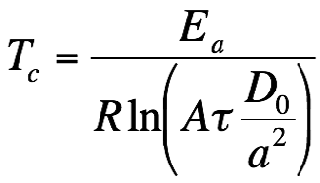
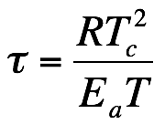
II. Closure temperature and He-PRZ
Tc: when 50% of produced He atoms is retained in the crystal
He-PRZ: between 10 to 90% of the retained He
Dodson (1973)
See EXERCICE 1
Using Gautheron and Tassan-Got (2010) code

Slide 31
II. Closure temperature example
Modified from Reiners (2005)
Tc = f(D₀, E_{a}, cooling rate, grain size)

Slide 32
II. Closure temperature and He-PRZ
TAKE HOME MESSAGE:
(U-Th-Sm)/He age is not the time when rock crosses the closure temperature (Tc) or very rarely
Diffusion domain and diffusion coefficient strongly influence thermochronometric age

Slide 33
(1) (U-Th)/He dating system
Introduction, generalities
(U-Th)/He principles (chronometer vs thermochronometer)
(2) How to get an (U-Th)/He age
(3) Applications
Apatite (U-Th-Sm)/He (AHe) method
Other applications (zircon, iron oxides,…)
(4) Exercises (Tc, ejection, weight, Rs), thermal modeling

Slide 34
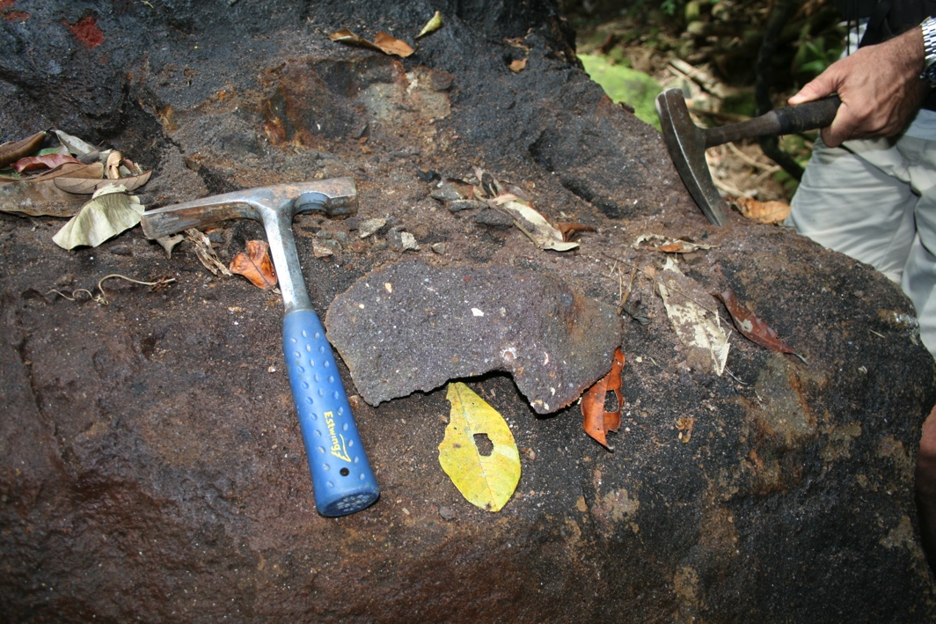
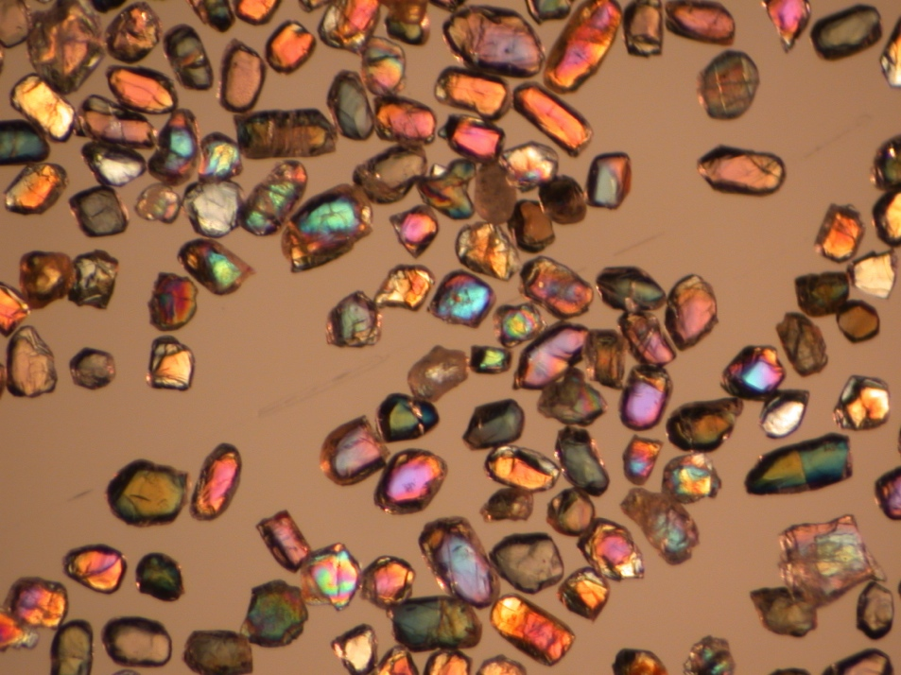
(2) From sample to grain separation
Crushing, sieving, cleaning...
Need of 1 to 10 kg of rock to obtain enough “datable” apatite grains

Slide 35
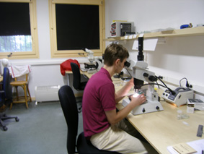
(2) Grain selection
100 μm
Ehlers and Farley (2003)
Drastic apatite selection criterion, grain size measurement + geometries (pyramids, broken faces)

Slide 36
(2) Grain morphology impact on AHe age interpretation
AHe age will be impacted by:
Crystal size (L, H, W),
Grain morphology,
Broken faces
Beucher et al. (2013); Brown et al. (2013)

Slide 37
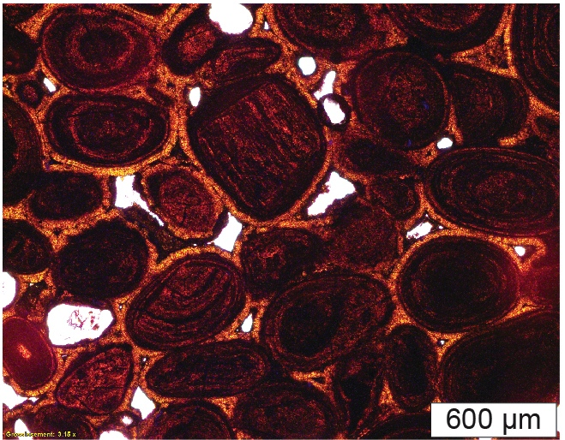
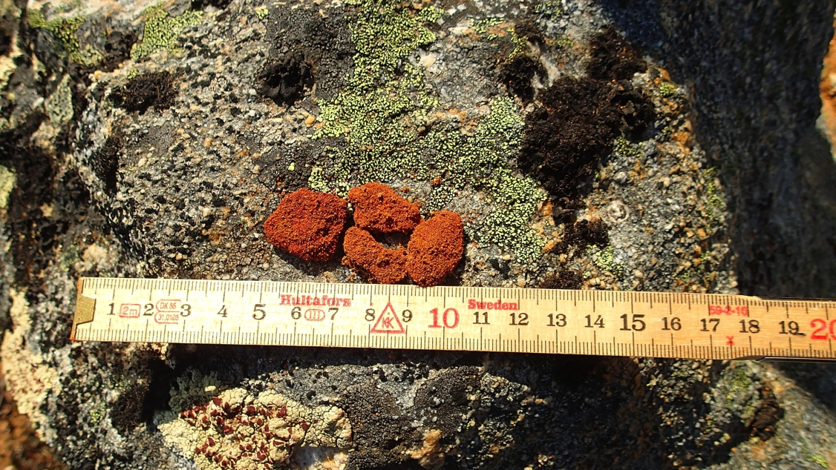
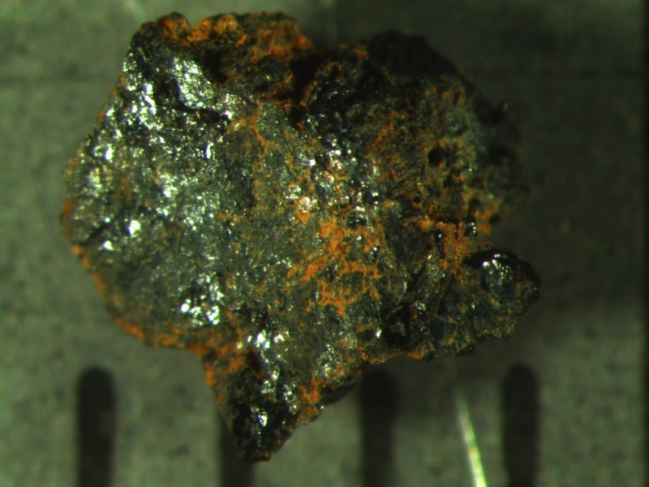
(2) From sample to grain separation
Iron oxide duricrusts or pisoliths
(crystallographic characterization)

Slide 38
(2) Alpha ejection correction factor (F_{T})
Farley et al. (1996)
Alpha ejection correction factor F_{T}:
- sphere with homogeneous U-Th-Sm repartition
For realistic geometries (2 approaches):
- Hexagonal ± pyramids, for homogeneous U-Th-Sm
Ketcham et al. (2011)

Slide 39
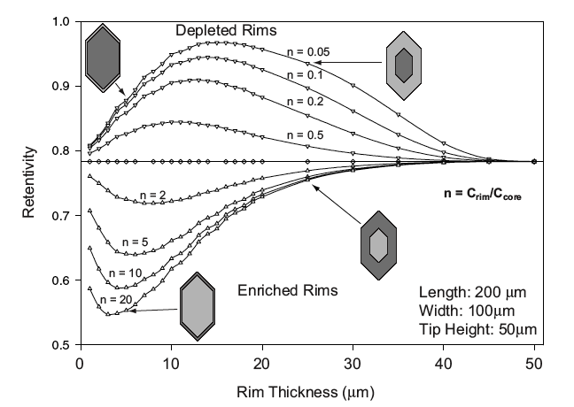
(2) Alpha ejection correction factor: zoned U-Th-Sm crystals (F_{ZAC})
For crystals zoned in U-Th-Sm, F_{ZAC} factor can be determined analytically or using a Monte Carlo simulation
Vernon et al. (2009)
Hourigan et al. (2005)

Slide 40
(2) Correcting factor, weight, diffusion domain
Calculation using a Monte Carlo model of:
Grain weight (μg)
F_{T}, F_{ZAC} alpha ejection correction (0 to 1)
Rs sphere equivalent radius (μm) for isotropic or anisotropic diffusion domain
Hexagonal (apatite)
Tetragonal (zircon)
± pyramids, broken faces
…
Need of a F_{T} > 0.65 and Rs > 40 μm…
Ketcham et al. (2011);
Gautheron et al. (2012)
http://hebergement.u-psud.fr/flojt/

Slide 41
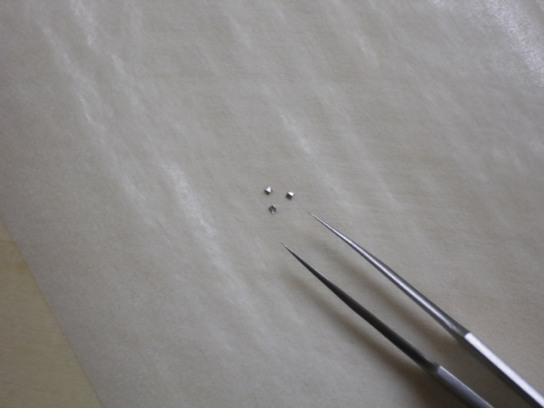
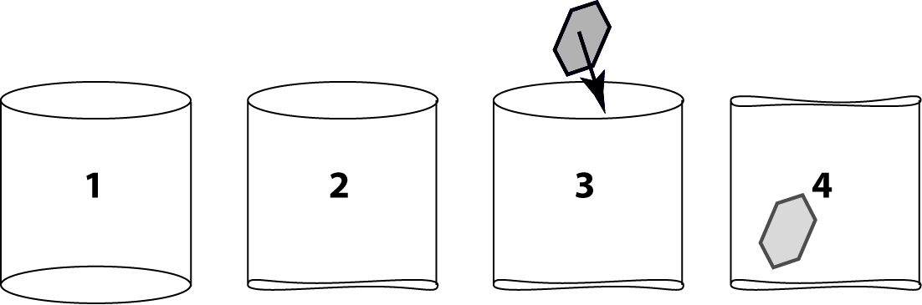
(2) Crystals packing: apatite , zircon, titanite… examples
Platinum tube (apatite), niobium tube (zircon, titanite) or niobium foil (iron oxides, calcite…)
Capsule is used to transport the grain(s) and to ensure He degassing (laser light absorption).

Slide 42
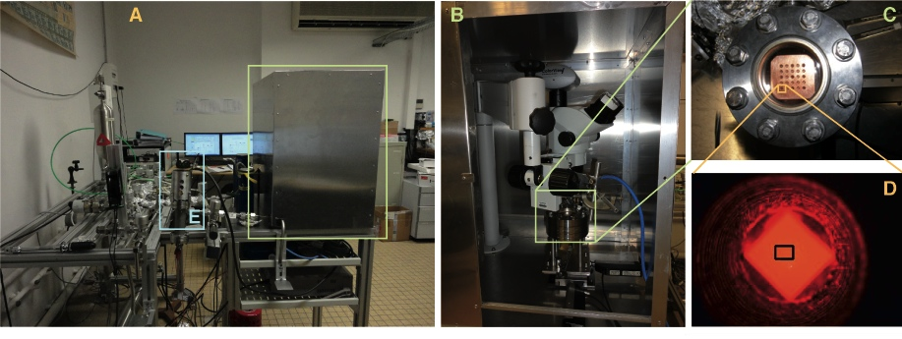
(2) ⁴He analysis
Extraction, purification and analysis line for ⁴He content determination at ~2%
Special gas purification for iron oxides (i.e. goethite) and calcite because of large H₂O and CO₂ degassing

Slide 43
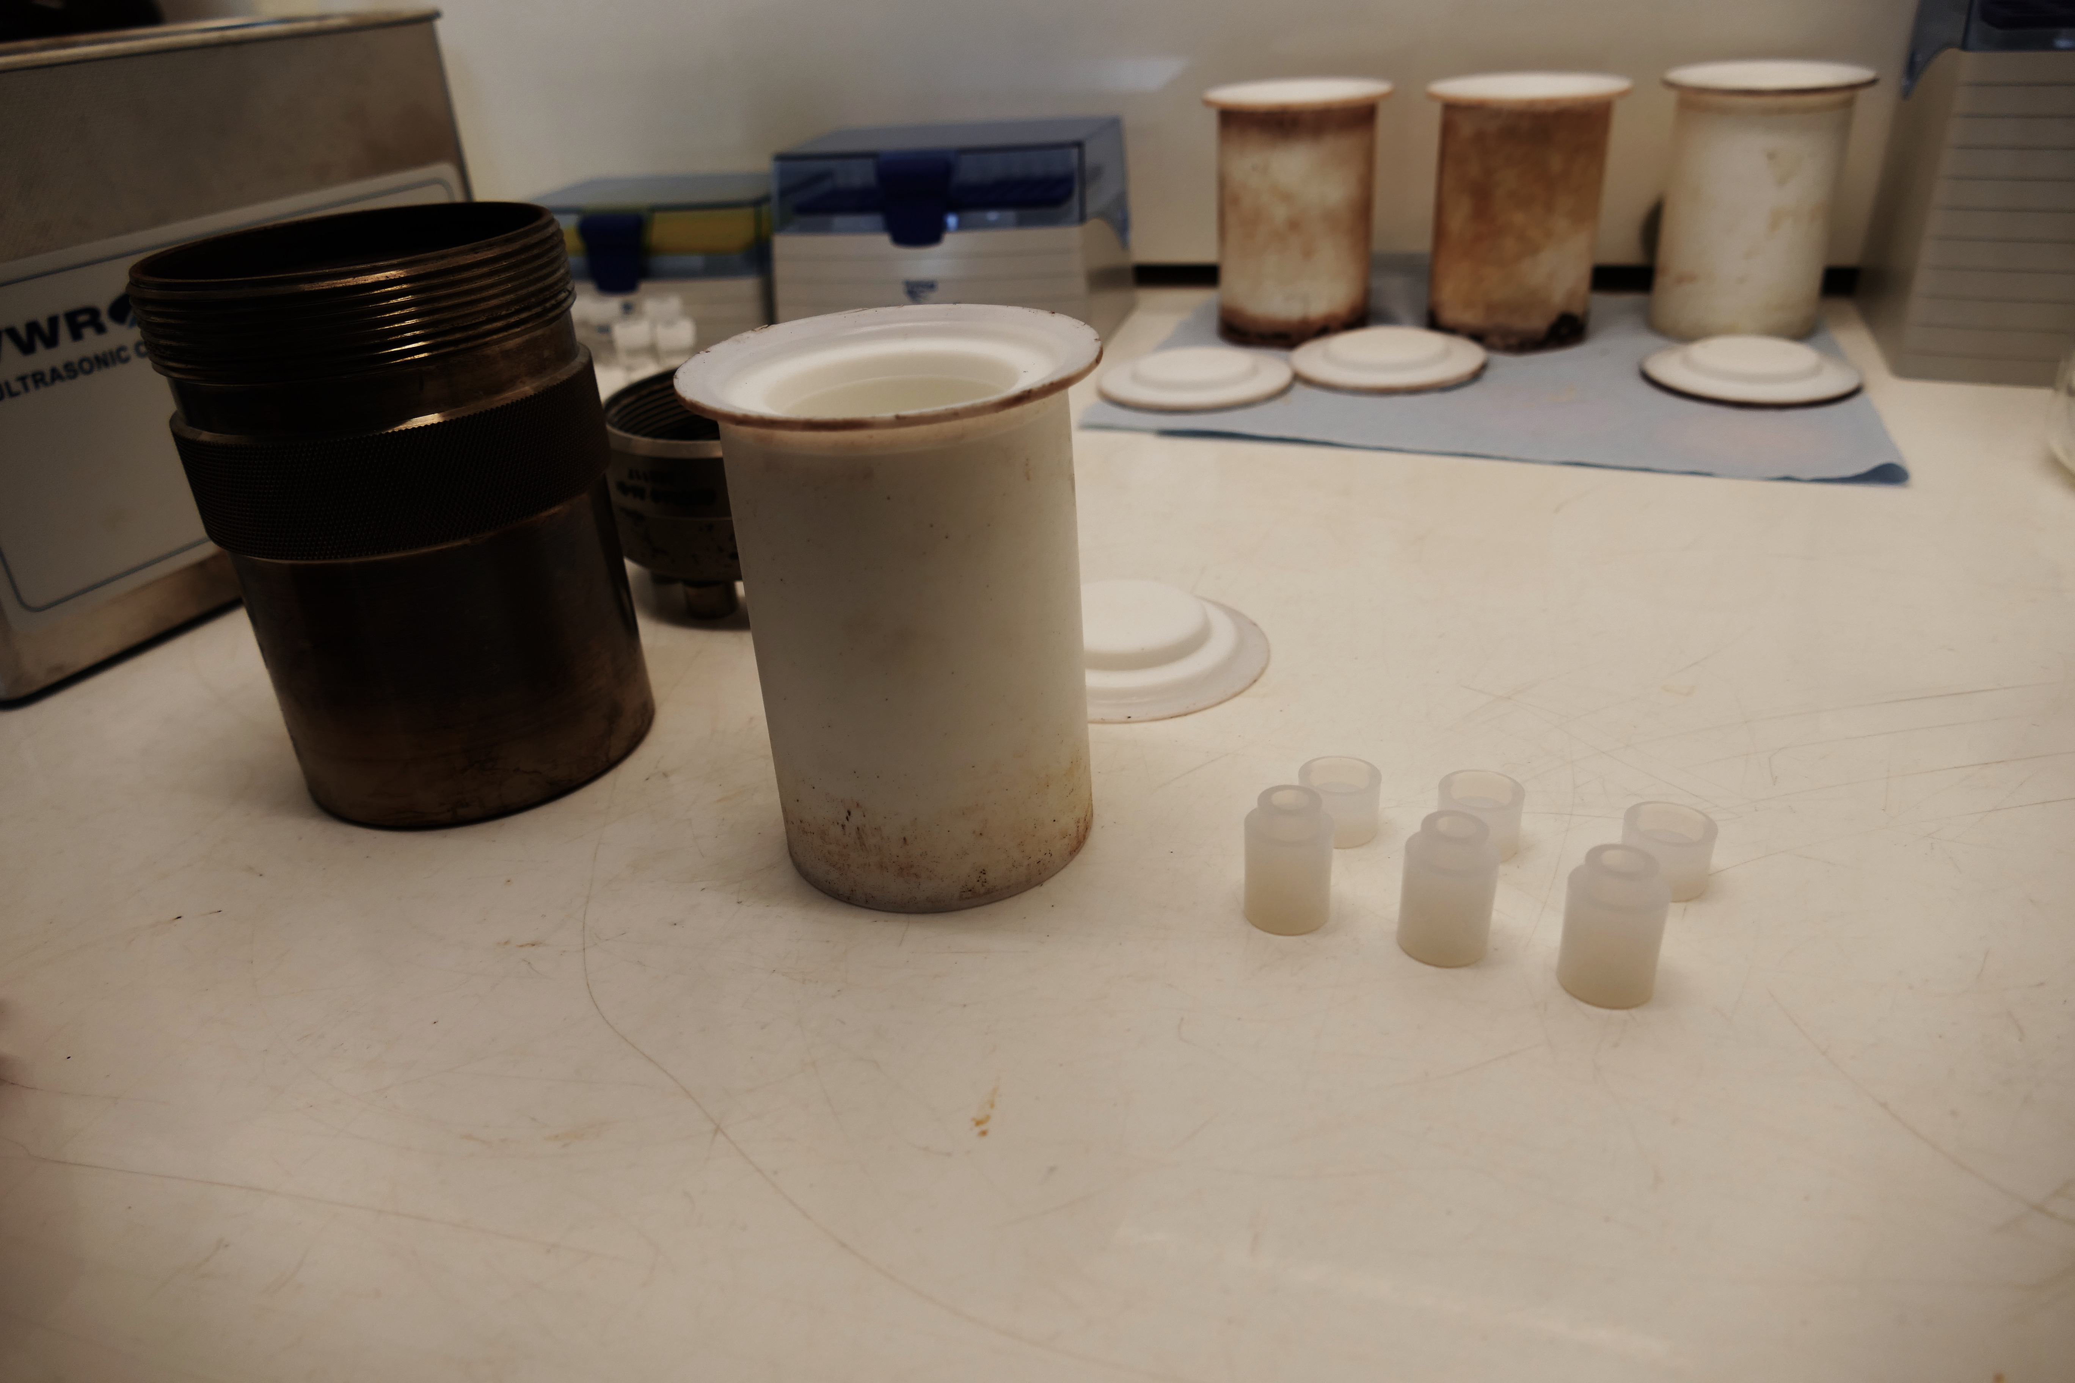
(2) U-Th-Sm analysis
Addition of pure selected isotopes (example: ²³⁵U, ²³⁰Th, ¹⁴⁹Sm) spikes during dissolution.

Slide 44
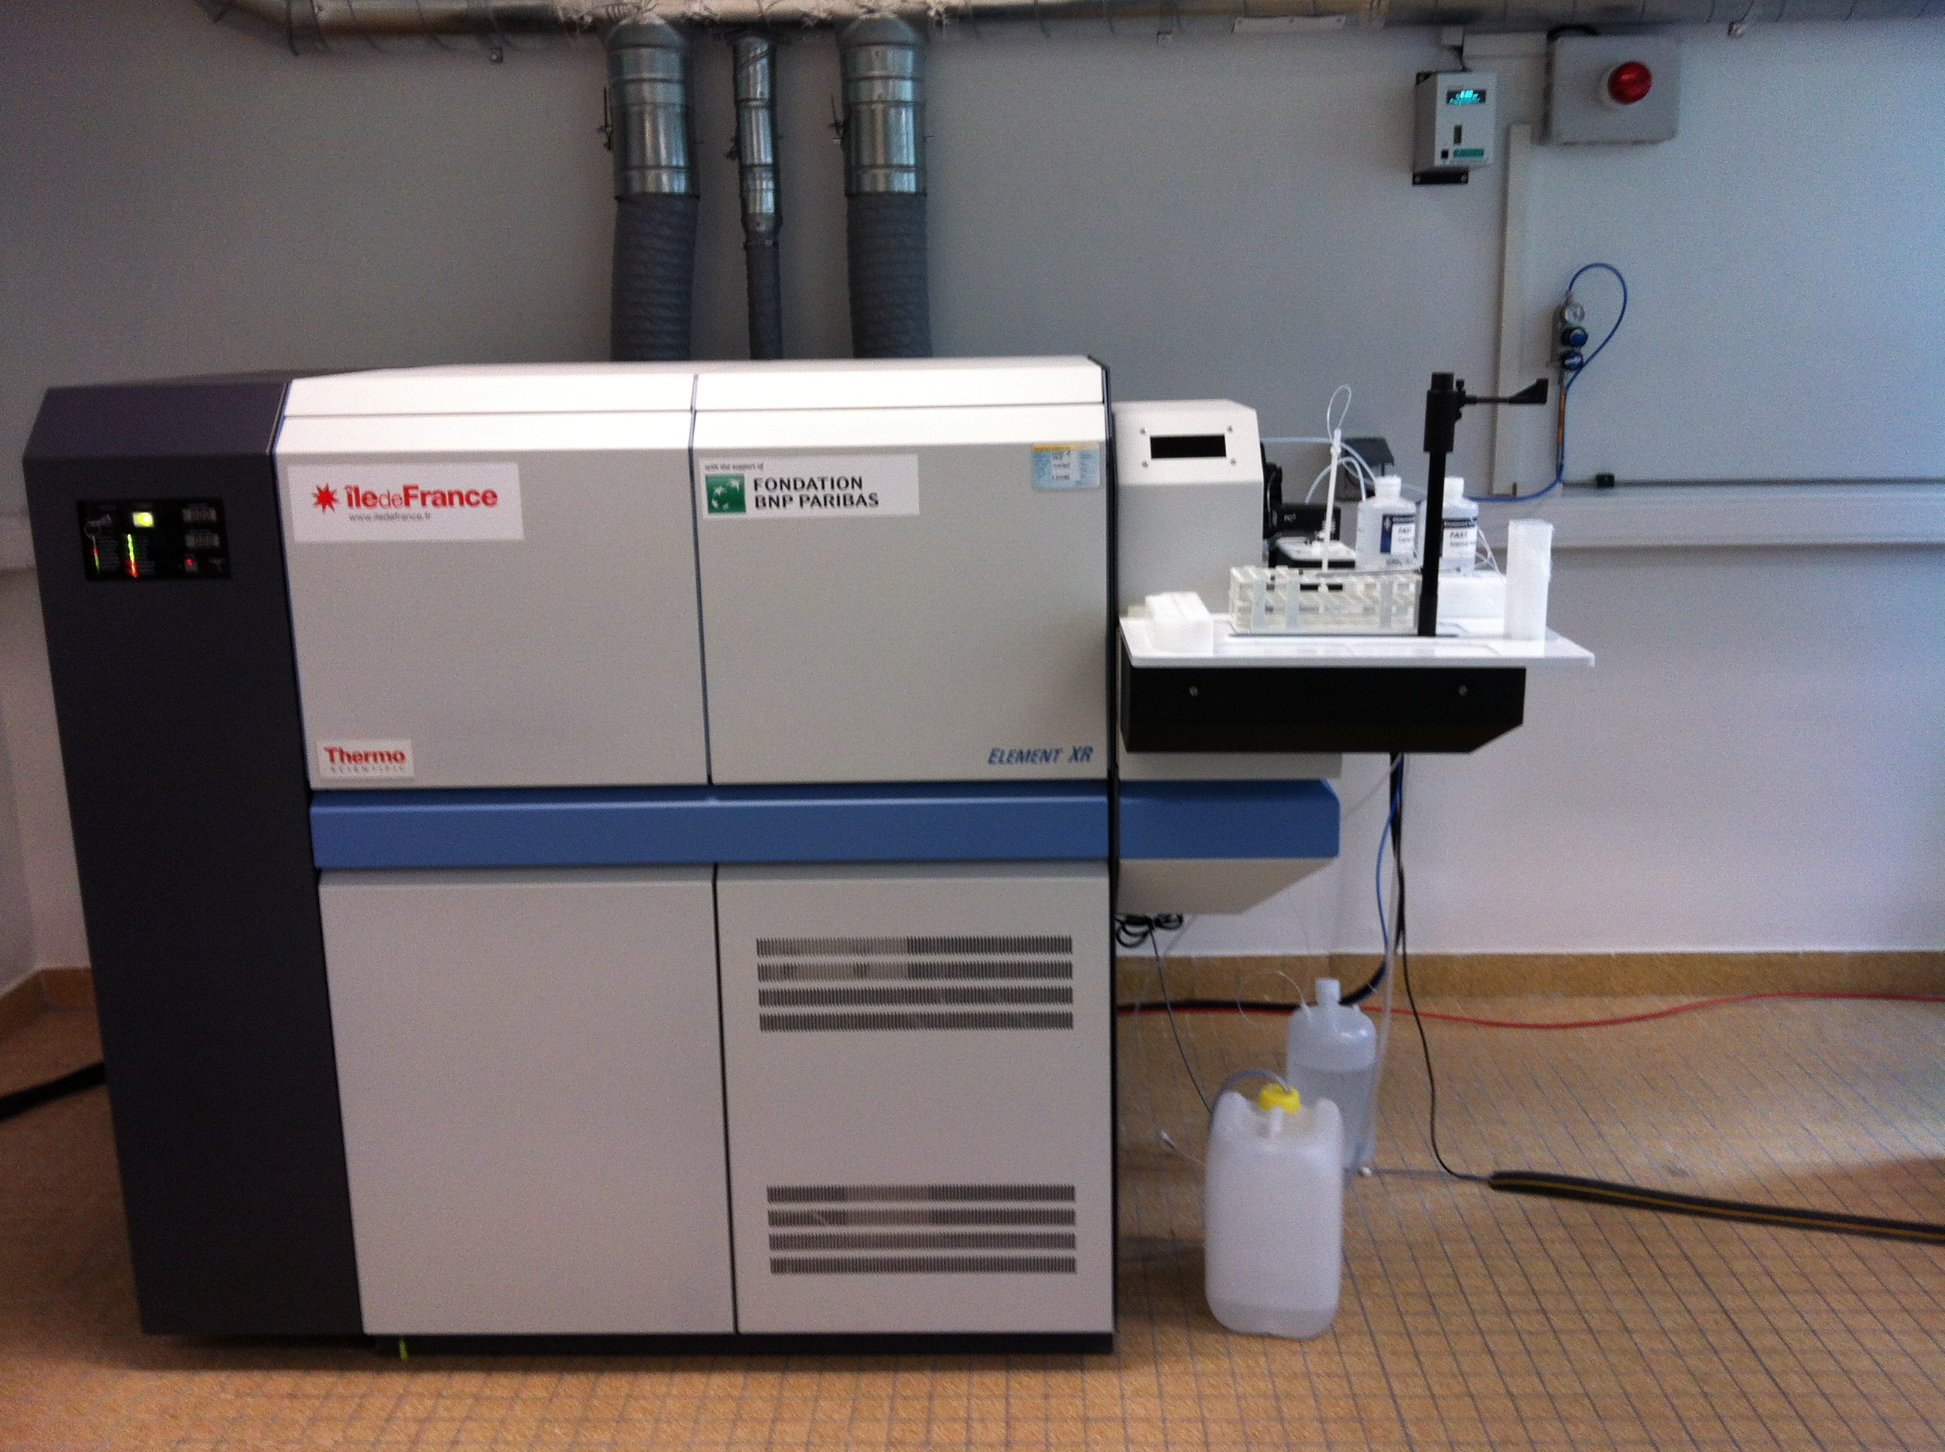
(2) U-Th-Sm analyses by ICPMS
²³⁸U, ²³²Th and ¹⁴⁷Sm determination by isotopic dilution method (see Evans et al., 2005 for details)

Slide 45
(2) Base hypothesis
U-Th decay series are on secular equilibrium (t>1Ma)
No U-Th-Sm loss
No common helium,
or ⁴He, ²¹Ne_{c} << ⁴He* (radiogenic)
No ⁴He implantation
from neighbor minerals
Gautheron et al. (2012)

Slide 46
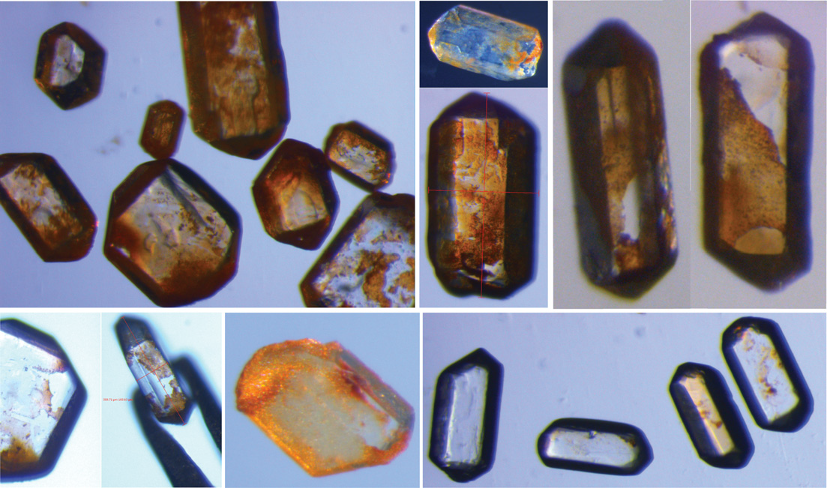
(2) Impact of He implantation on AHe age
From Murray et al. (2014);
See also Spiegel et al. (2009);
Janowski et al. (2017)

Slide 47
(2) (U-Th-Sm)/He age calculation
(U-Th-Sm)/He age:
He instantaneous production (P* / per year):
Alpha ejection corrected age:

Slide 48
(2) He age reproducibility
Durango: McDowell et al. (2005); Limberg: Kraml et al. (2006)
Analytical age: <4% = <2% for He and <2% for U-Th-Sm measurements
Error on He age with ejection factor => 8-10%

Slide 49
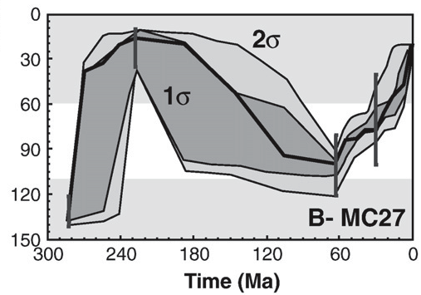
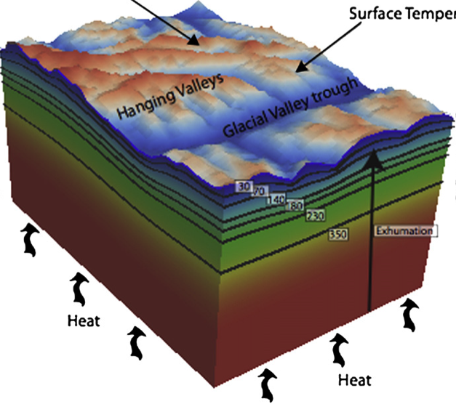
(2) Inversion of low temperature thermochronological data
HeFTy :
Tt path modeling
PECUBE :
3D modeling + vertical profile + faults …
QTQt :
- Tt + pluri-samples (vertical profile) modeling
Temperature (°C)
Ketcham (2005); Gallagher (2012): Braun (2003)

Slide 50
2) Data acquisition
TAKE HOME MESSAGE:
Do not underestimate the time to prepare and pick your grains (especially for apatite)
Measure all grains geometry and report all data (L, H, W, geometries)
Error on (U-Th)/He age will be ~10%

Slide 51
(1) (U-Th)/He dating system
Introduction, generalities
(U-Th)/He principles (chronometer vs thermochronometer)
(2) How to get an (U-Th)/He age
(3) Applications
Apatite (U-Th-Sm)/He (AHe) method
Other applications (zircon, iron oxides,…)
(4) Exercises (Tc, ejection, weight, Rs), thermal modeling

Slide 52
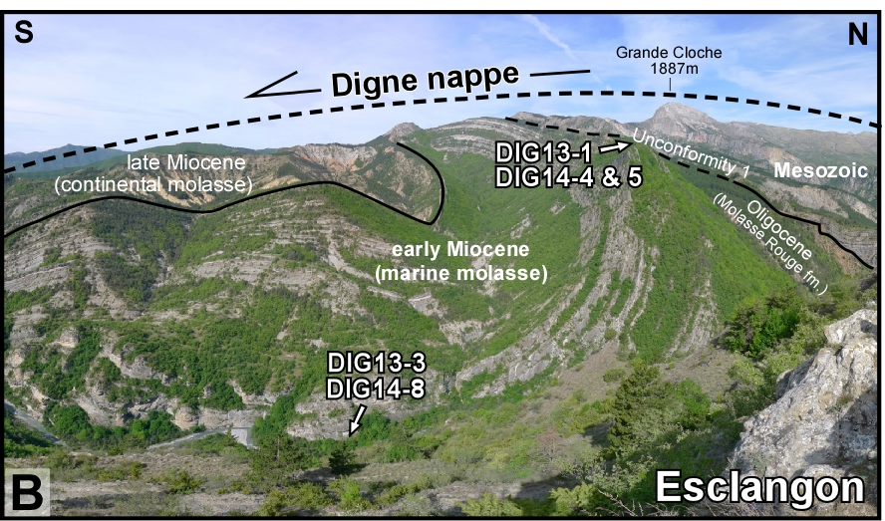
III. Apatite He age distribution
AHe age dispersion is often higher than analytical error (~8%)
French foreland example (buried detrital apatite)
Schwartz et al. (2017)
Important dispersion for higher elevation sample => non total diffusion?

Slide 53
III. Apatite He age distribution
Moroccan margin exhumed during Atlantic breakoff
Leprêtre et al. (2015)
Important AHe age dispersion: relation with eU content?

Slide 54
III. Apatite He diffusion coefficient
Published He diffusion coefficient using different methods:
Under vacuum degassing experiments
Ion beam experiments
DFT calculation
<
“Std kinetic”
Farley (2000)
Complied 1987-2010 data by Baxter (2010)

Slide 55
III. Relationship between eU and AHe age
Shuster et al. (2006); Trachenko (2003);
See Green et al. (2006) for similar observation
Model where He atoms are trapped into damage zone => increase of He retention in apatite crystal and Tc value

Slide 56
III. Relationship between damage and diffusion coefficient
Shuster et al. (2006);
Shuster and Farley (2009)
Empirical data showing the change of diffusion coefficient with artificial damage content
=> Tc ranges from 40 to > 100°C

Slide 57
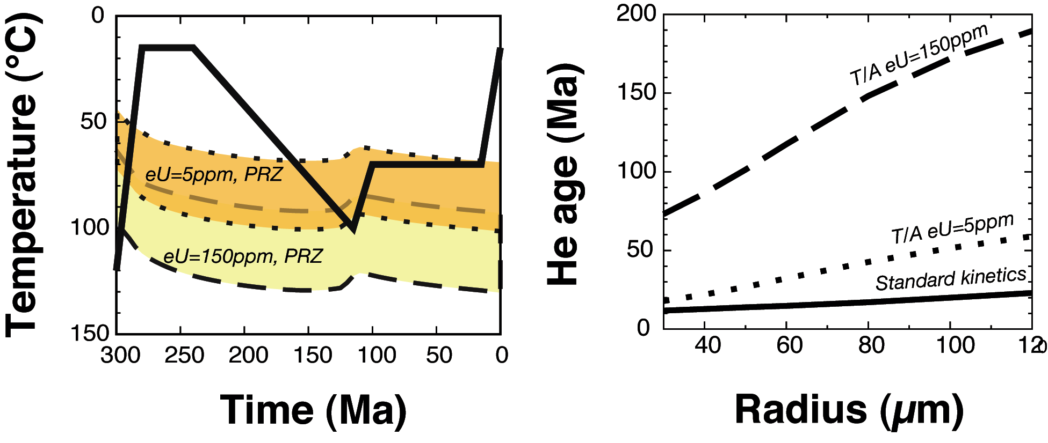
III. Implication of damage content on He-PRZ
Gautheron et al. (2009)
Damage production and change of He diffusion, will change the Tc and He-PRZ through time

Slide 58
III. Diffusion in complex system: damage trapping + annealing model
Two damage + annealing models are used :
Flowers et al. (2009): calibrated on natural + irradiated samples
Gautheron et al. (2009): calibrated on “old” natural AHe ages

Slide 59
III. Chemical impact on diffusion
Djimbi et al. (2015)
Gautheron et al. (2009);
Flowers et al. (2009)
Chemical impact on He diffusion
Lower Tc for undamaged apatite Tc=30-40°C

Slide 60
III. Chemical impact on diffusion
Apatite chemistry play a role on damage annealing rate (such as for apatite fission tracks)
High Cl and/or Dpar
Low Cl and/or Dpar
Modified from Gautheron et al. (2013);
Modeling: HeFTy Ketcham (2005) + Flowers et al. (2009)
(See EXERCICE 3)

Slide 61
III. Damage impact on diffusion
Gerin et al. (2017)
We are currently calibrating the new He damage model
New code will be implemented into QTQt and HeFTy in 2018

Slide 62
III. Use of apatite He age dispersion
Schwartz et al. (2017)
Simulation QTQt (Gallagher, 2012), with Flowers et al. (2009) code
AHe age dispersion is useful to refine not only the burial time and temperature

Slide 63
III. Impact of chemistry and grain size on AHe age dispersion
Leprêtre et al. (2015);
QTQt simulation using AHe and AFT data (Gallagher (2012)
Need to consider grain chemistry variation in addition to grain size and damage model

Slide 64
III. AHe age interpretation
TAKE HOME MESSAGE:
A geological meaning is associated with AHe age dispersion as the age reflects the impact of:
Grain size (diffusion domain)
Damage content (eU + time + annealing via chemistry)
Thermal history
Adapt the number of analyzed grains as a function of thermal history (3 to > 10 apatite crystals)

Slide 65
(1) (U-Th)/He dating system
Introduction, generalities
(U-Th)/He principles (chronometer vs thermochronometer)
(2) How to get an (U-Th)/He age
(3) Applications
Apatite (U-Th-Sm)/He (AHe) method
Other applications (zircon, iron oxides,…)
(4) Exercises (Tc, ejection, weight, Rs), thermal modeling

Slide 66
IV. Others applications
(U-Th)/He system can be applied to a large range of minerals
Which geological application ?
Higher temperature information than apatite => zircon, titanite
Ore deposit, laterite dating => goethite, hematite, magnetite

Slide 67
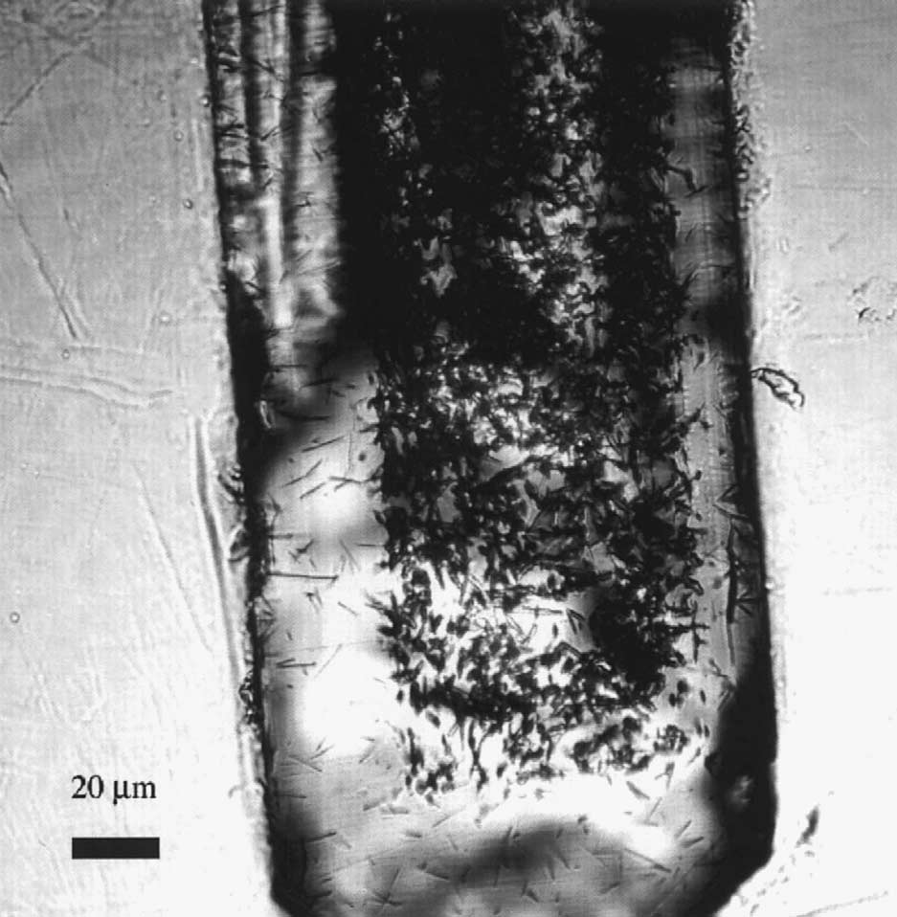
IV. Zircon (U-Th)/He (ZHe) method
Zircon crystal can be found in a large variety of rocks (plutonic, volcanic and sedimentary)
Rich U-Th content: eU= 100 to 3000 ppm (He production from Sm is “null”)
U-Th zoned crystal
Lower stopping distance
Tagami et al. (2003)

Slide 68
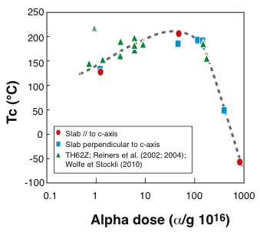
IV. Zircon (U-Th)/He (ZHe) method
Tc= 140-200°C (>AHe)
Strong modification of diffusion coefficient by recoil damage,
Damage clustering and interconnection
Lattice amorphisation at high dose
Guenthner et al. (2013)

Slide 69
IV. Interpretation of ZHe data
Guenthner et al. (2013)
Used of ZHe data dispersion to determine a precise thermal history, similarly to AHe

Slide 70
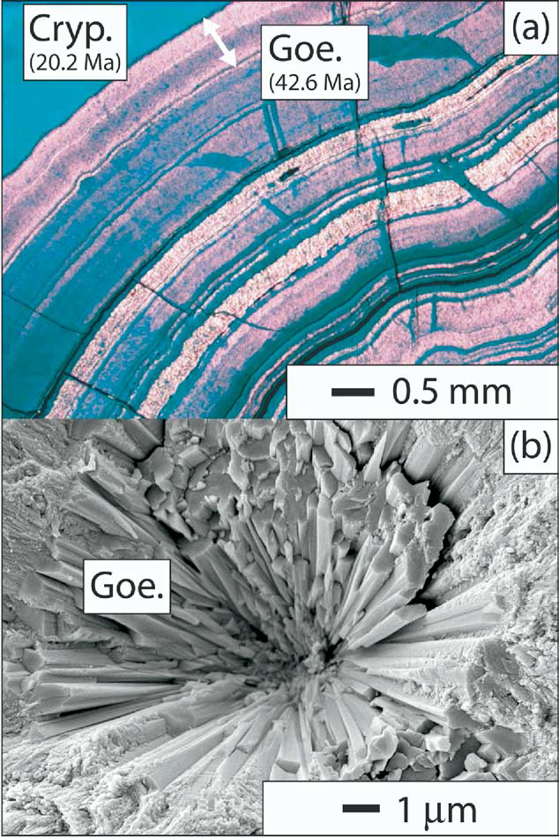
IV. Laterite, ore deposit dating
Laterite surface development reflects intense weathering phases
Crystallization of supergene mineralogical phases:
Iron oxides (H – G)
K-Mn oxides
Kaolinites
Shuster et al. (2005); Vasconcelos et al. (205)

Slide 71
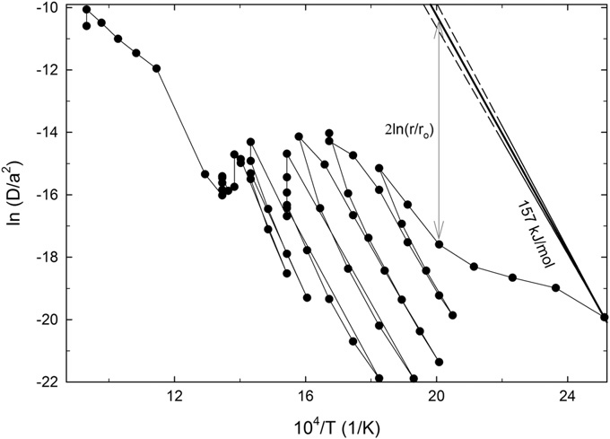
IV. Iron oxides
He diffusion behavior in hematite and goethite
5 to 30 % He loss due to “tiny” polycrystalline samples
Crystals of 0.1 μm
Shuster et al. (2005);
Farley and Flowers (2012);
Balout et al. (2017);
Allard et al. (Submitted)
Hematite
Goethite
T_{c} (He)= 56°C
T_{c} (He)~ 49°C

Slide 72
IV. Ore deposits
Ore-deposit formation : Carajas Mountains (Brazil)
Vasconcelos et al. (2015)
and references therein

Slide 73
IV. Ore deposits
All Amazonian and Australian laterites ages
Vasconcelos et al. (2015) and references therein
Similar ages given by the K-Ar/Ar-Ar and (U-Th)/He systems

Slide 74
IV. Others applications
TAKE HOME MESSAGE :
(U-Th-Sm)/He dating can be applied to many systems if:
Crystal contains U-Th-Sm AND
Produced He atoms are quantitatively retained in crystal lattice at surface temperatures (because of diffusion ~Tc>40°C) AND
Grain or sample (made of polycrystalline grains) size are > 100 μm (because of significant alpha ejection) AND
Possible strong damage impact on crystal lattice

Slide 75
(1) (U-Th)/He dating system
Introduction, generalities
(U-Th)/He principles (chronometer vs thermochronometer)
(2) How to get an (U-Th)/He age
(3) Applications
Apatite (U-Th-Sm)/He (AHe) method
Other applications (zircon, iron oxides,…)
(4) Exercises (Tc, ejection, weight, Rs), thermal modeling

Slide 76
(4) Exercices
Different exercises using diffusion coefficient (or Tc), and notions seen during lecture: ejection, diffusion domain, age calculation and dispersion
Closure temperature calculation
Alpha ejection, Rs, weight determination (Qtflojt)
AHe age simulation using HeFty

Slide 77
(4) Ex 1. closure temperature calculation
With the given D₀ and E_{a}, calculate the closure temperature Tc, for a given cooling rate and grain size (a)
Ea (kJ/mol) | 139.5
D₀ (m²/s⁻¹) | 3.37x10⁻²
Dodson (1973)
With R=8.31 J/mol/K; A=55 and T=273 K

Slide 78
(4) Ex 1. closure temperature calculation
Using an excel sheet, enter the need values need
 | values
Ea (J/mol) | 139528,4
D₀ (m²/s⁻¹) | 3,37E-02
a (m) | 1,70E-04
D₀/a² | 1,17E+06 | !! Values to change !!
R | 8,31
A (sphère) | 55 | T1 Temperature (°C)
T (°K) | 345,00 | 72,00
 |  | Cooling rate (°C/Ma)
Cooling rate (°/s) | 3,17E-13 | 10
tau | 2,24E+13
Tc (°K) | 345
Closure temp Tc (°C) | 71,66 | When it’s the same value of T1
conversion 1 cal => 4.18 J/mol

Slide 79
(4) Ex 2. grain characteristics
You have carefully selected apatite crystals and reported all measurements. Using those values, calculate the:
Apatite weight
Rs (equivalent diffusion domain)
F_{T} (ejection factor)
For one sample, you are not sure if the termination was 2 broken faces or no pyramids. Test the influence on the F_{T} factor.
Test the influence of U-Th zonation on the F_{T} factor.
Calculate the corrected AHe age and estimate the maximum age dispersion induced by the F_{T} factor (geometries, zoning)
100 μm

Slide 80
(4) Ex 2. grain characteristics
For grain measurement, you get the following data:
Name | Geometry | H (µm) | W (µm) | T (µm) | Weights (µg) | FT | Rs (µm)
Hel_1 | 2bf | 200 | 125 | 115 | 6.8 | 0.83 | 64.8
Hel_2 | 1+1 | 160 | 125 | 115 | 4.2 | 0.80 | 59.8
Hel_3 | No py | 200 | 145 | 140 | 9.4 | 0.81 | 73.5
Hel-4 | 2 bf | 150 | 80 | 70
With:
2 bf=2 broken faces |  |  | 1+1=1 pyramid + 1 bf
No py=No pyramids

Slide 81
(4) Ex 2. grain characteristics
Ketcham et al. (2011); Gautheron et al. (2012)
Selected the grain shape
Grain geometry
Grain size
Use a Th/U value
For zonation, selected where the U-Th content is localized and normalized amount and size.
http://hebergement.u-psud.fr/flojt/

Slide 82
(4) Ex 2. grain characteristics
With He, U, Th and Sm, you get the raw age for your sample.
Calculate the alpha ejection corrected age
Estimate the error on AHe age, by determining also the error associated with the determination of the F_{T} factor, knowing that the analytical error was at 4%.
Name | F_{T} | _{s} | Rs | ⁴He | U | Th | Sm | eU | Th/U | Raw age | Cor age | σ
 |  |  | (µm) | (nmol/g) | (ppm) |  |  |  |  | (Ma)
Hel_1 | 0.83 | 4% | 64.8 | 2,21 | 17 | 61 | 296 | 31 | 3,7 | 12,2 | 14.7 | 8%
Hel_2 | 0.80 | 4% | 59.8 | 34,19 | 103 | 265 | 383 | 167 | 2,6 | 37,4 | 46.7 | 8%
Hel_3 | 0.81 | 4% | 73.5 | 0,11 | 1 | 4 | 275 | 2 | 4,8 | 4,8 | 5.9 | 8%

Slide 83
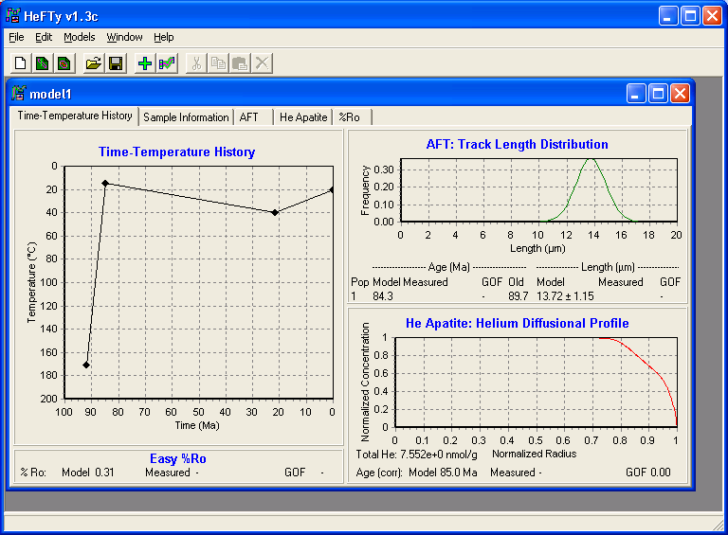
(4) Ex 3. AHe age simulation
Using HeFTy, we will simulate AHe, ZHe and AFT age distribution
Ketcham (2005)

Slide 84
(4) Ex 3. AHe age simulation
Test on AHe and ZHe age for two different thermal histories (A and B), the impact of:
Grain size,
eU content
grain chemistry (for apatite via the rmr₀)

Slide 85
Cited references

Slide 86
Cited references
Balout, H., Roques, J., Gautheron, C., Tassan-Got, L., Mbongo-Djimbi, D., 2017. Helium diffusion in pure hematite (α-Fe2O3) for thermochronometric applications: a theoretical multi-scale study. Computational and Theoritical Chemistry, 1099: 21-28.
Baxter, E.F., 2010. Diffusion of Noble Gases in Minerals. In: America, M.S.o. (Ed.), Diffusion in minerals and melts, pp. 509-557.
Bengtson, A., Ewing, R.C., Becker, U., 2012. He diffusion and closure temperatures in apatite and zircon: A density functional theory investigation. Geochimica et Cosmochimica Acta, 86: 228-238.
Beucher, R., Brown, R.W., Roper, S., Stuart, F., Persano, C., 2013. Natural age dispersion arising from the analysis of broken crystals, Part II. Practical application to apatite (U-Th)/He thermochronometry. Geochim. Cosmochim. Acta, 120: 395-416.
Braun, J., 2003. Pecube: A new finite element code to solve the heat transport equation in three dimensions in the Earth’s crust including the effects of a time-varying, finite amplitude surface topography. Computers and Geosciences, 29: 787-794.
Braun, J., van der Beek, P., Batt, G., 2002. Quantitative thermochronology: Numerical methods for the interpretation of thermochronological data.
Brown, R.W. et al., 2013. Natural age dispersion arising from the analysis of broken crystals, Part I. Theoretical basis and implications for the apatite (U-Th)/He thermochronometer. Geochim. Cosmochim. Acta, 122: 478-497.
Cherniak, D.J., Watson, E.B., Thomas, J.B., 2009. Diffusion of helium in zircon and apatite. Chem. Geol., 268: 155-166.
Copeland, P., Watson, E.B., Urizar, S.C., Patterson, D., Lapen, T.J., 2007. Alpha thermochronology of carbonates. Geochim. Cosmochim. Acta, 71: 4488-4511.
Cros, A. et al., 2014. 4He behavior in calcite filling viewed by (U-Th)/He dating, 4He diffusion and crystallographic studies. Geochim. Cosmochim. Acta, 125: 414-432.

Slide 87
Cited references
Djimbi, D.M. et al., 2015. Impact of apatite chemical composition on (U-Th)/He thermochronometry: an atomistic point of view. Geochim. Cosmoch. Acta, 167: 162-176.
Dodson, M.H., 1973. Closure temperature in cooling geochronological and petrological systems. Contrib. Min. Petrol., 40: 259-274.
Ehlers, T.A., Farley, K.A., 2003. Apatite (U+Th)/He thermochronometry: methods and applications to problems in tectonic and surface processes. Earth Planet. Sci. Lett., 206: 1-14.
Evans, N.J., Byrne, J.P., Keegan, J.T., Dotter, L.E., 2005. Determination of uranium and thorium in zircon, apatite, and fluorite: Application to laser (U-Th)/He thermochronology. Journal of Analytical Chemistry, 60(12): 1300-1307.
Farley, K.A., 2000. Helium diffusion from apatite: general behavior as illustrated by Durango fluorapatite. J. Geophys. Res., 105: 2903-2914.
Farley, K.A., 2002. (U-Th)/He dating: Techniques, calibrations, and applications. In: geochemistry, R.i.m. (Ed.), Noble Gases in Geochemistry and Cosmochemistry, pp. 819-844.
Farley, K.A., Flowers, R., 2012. (U-Th)/Ne and multidomain (U-Th)/He systematics of a hydrothermal hematite from Eastern Grand Canyon. Earth and Planetary Science Letters, 359-360: 131-140.
Farley, K.A., Wolf, R.A., Silver, L.T., 1996. The effects of long alpha-stopping on (U-Th)/He ages. Geochim. Cosmochim. Acta, 21: 4223-4229.
Flowers, R., Ketcham, R.A., Shuster, D., Farley, K.A., 2009. Apatite (U-Th)/He thermochronology using a radiation damage accumulation and annealing model. Geochim. Cosmochim. Acta, 73: 2347-2365.
Gallagher, K., 2012. Transdimensional inverse thermal history modelling for quantitative thermochronology. JGR, 117(B02408): 16pp.
Gautheron, C. et al., 2013. Chemical influence on α-recoil damage annealing in apatite: implications for (U-Th)/He dating. Chem. Geol., 351: 257-267.

Slide 88
Cited references
Gautheron, C. et al., en prep. Comparative study of He and Ne diffusion in zircon by a multi-scale approach: implication for the (U-Th)/He/Ne chronometers. Chem. Geol.
Gautheron, C., Tassan-Got, L., 2010. A Monte Carlo approach of diffusion applied to noble gas/helium thermochronology. Chemical Geology, 273: 212-224.
Gautheron, C., Tassan-Got, L., Ketcham, R.A., Dobson, K.J., 2012. Accounting for long alpha-particle stopping distances in (U-Th-Sm)/He geochronology: 3D modeling of diffusion, zoning, implantation, and abrasion. Geochimica et Cosmochimica Acta, 96: 44-56.
Gautheron, C.E., Tassan-Got, L., Barbarand, J., Pagel, M., 2009. Effect of alpha-damage annealing on apatite (U-Th)/He thermochronology. Chemical Geology, 266: 166-179.
Gerin, C. et al., 2017. Influence of vacancy damage on He diffusion in apatite investigated at atomic to mineralogical scales. Geochim. Cosmoch. Acta, 197: 87-103.
Green, P.F., Crowhurst, P.V., Duddy, I.R., Jaspen, P., Holford, S.P., 2006. Conflicting (U-Th)/He and fission track ages in apatite: Enhanced He retention, not annealing behaviour. Earth Planet. Sci. Lett., 250: 407-427.
Guenthner, W., Reiners, P.W., Ketcham, R., Nasdala, L., Giester, G., 2013. Helium diffusion in natural zircon: radiation damage, anisotropy, and the interpretation of zircon (U-Th)/He thermochronology. American Journal of Science, 313: 145-198.
Janowski, M. et al., 2017. Neogene exhumation and relief evolution in the eastern Betics (SE Spain): insights from the Sierra de Gador. Terra Nova, 29: 91-97.
Ketcham, R.A., 2005. Forward and inverse modelling of low-temperature thermochronolgy data. In: Reiners, P.W.a.E., T.A. (Ed.), Low temperature thermochronology: techniques, interpretations and applications. Reviews in mineralogy and geochemistry, pp. 275-314.
Ketcham, R.A., Carter, A., Donelick, R.A., Barbarand, J., Hurford, A.J., 2007. Improved modeling of fission-track annealing in apatite. American Mineralogist, 92: 799-810.

Slide 89
Cited references
Ketcham, R.A., Gautheron, C., Tassan-Got, L., 2011. Accounting for long alpha-particle stopping distances in (U-Th-Sm)/He geochronology: refinement of the baseline case. Geochimica et Cosmochimica Acta, 75: 7779-7791.
Ketcham, R.A., Guenthner, W.R., Reiners, P.W., 2013. Geometric analysis of radiation damage connectivity in zircon, and its implications for helium diffusion. American Mineralogist, 98: 350-360.
Kraml, M. et al., 2006. A new multi-mineral age reference material for 40Ar/39Ar, (U-Th)/He and fission track dating methods: The Limberg t3 tuff. Geostandards and Geoanalytical Research, 30(2): 73-86.
Leprêtre, R. et al., 2015. Post-rift history of the eastern Central Atlantic passive margin: insights from the Saharan region of South Morocco. Journal of Geophysical Research - Solid Earth, 120.
Lovera, O.M., Richter, F.M., Harrison, T.M., 1989. The 40Ar/39Ar thermochronology for slowly cooled samples having a distribution of Diffusion Domain Sizes. . Journal of Geophysical Research, 94(B12): 17,917-17,935.
Lovera, O.M., Richter, F.M., Harrison, T.M., 1991. Diffusion domains determineb dy 39Ar released during step heeating. J. Geophys. Res., 96(B2): 2957-2069.
McDowell, F.W., McIntosh, W.C., Farley, K.A., 2005. A precise 40Ar-39Ar reference age for the Durango apatite (U-Th)/He and fission-track dating standard. Chem. Geol., 214(3-4): 249-263.
Ouchani, S., Dran, J.-C., Chaumont, J., 1998. Exfoliation and diffusion following helium ion implantation in fluorapatite: implications for radiochronology and radioactive waste disposal. Applied Geochemistry, 13(6): 707-714.
Reiners, P.W., 2005. Zircon (U-Th)/He thermochronometry. In: Reiners, P.W., Ehlers, T.A. (Eds.), Thermochronology, Reviews in Mineralogy and Geochemistry, pp. 151-179.
Reiners, P.W., Farley, K.A., 2001. Influence of crystal size on apatite (U+Th)/He thermochronology: an example from the Bighorn Mountains, Wyoming. Earth Planet. Sci. Lett., 188: 413-420.

Slide 90
Cited references
Shuster, D., Farley, K.A., 2005a. 4He/3He thermochronometry: theory, practice, and potential complications. In: Reiners, P.W.a.E., T.A. (Ed.), Low-temperature thermochronology: techniques, Interpretations, and Applications.
Shuster, D., Farley, K.A., 2005b. Diffusion kinetics of proton-induced 21Ne, 3He, and 4He in quartz. Geochim. Cosmochim. Acta, 69(9): 2349-2359.
Shuster, D., Flowers, R., Farley, K.A., 2006. The influence of natural radiation damage on helium diffusion kinetics in apatite. Earth Planet. Sci. Lett., 249: 148-161.
Spiegel, C., Kohn, B., Belton, D., Berner, Z., Gleadow, A., 2009. Apatite (U-Th-Sm)/He thermochronology of rapidely cooled samples: The effect of He implantation. Earth Planet. Sci. Lett., 285: 105-114.
Trachenko, K., Dove, M.T., Salje, E.K.H., 2002. Structural changes in zircon under a-decay irradiation. Physical Review B, 65: 18012.
Valla, P. et al., 2012. Late Neogene exhumation and relief development of the Aar and Aiguilles Rouges massifs (Swiss Alps) from low-temperature thermochronology modeling and 4He/3He thermochronometry. Journal of Geophysical Research, 117(F01004): 1-23.
Vasconcelos, P.M., Reich, M., Shuster, D., 2015. The paleoclimatic signatures of supergene metal deposits. Elements, 11: 317-322.
Wolf, R.A., Farley, K.A., Silver, L.T., 1996. Helium diffusion and low-temperature thermochronology of apatite. Geochim. Cosmochim. Acta, 60: 4231-4240.
Zeitler, P.K., Herczerg, A.L., McDougall, I., Honda, M., 1987. U-Th-He dating of apatite: A potential thermochronometer. Geochim. Cosmochim. Acta, 51: 2865-2868.
Ziegler, J.F., 2008. SRIM-2008 The stopping range of ions in matter. United States Naval Academy, Annapolis.

